Slide 1

MOVIE
RECCOMENDATION SYSTEM
25 April 2025
ANANYA SHARMA E23CSEU2227
MADHAV BUDHIRAJA E23CSEU2238

Slide 2
Introduction
Overview of Movie Recommendation System

Slide 3

SVD Model
25 April 2025
Using Singular Value Decomposition (SVD) for Recommendations
Singular Value Decomposition, or SVD, is a powerful technique used in
building recommendation systems, especially for movies. It helps the system understand the hidden patterns in user preferences and movie features. Instead of just looking at direct ratings, SVD breaks down the large user- movie rating matrix into smaller, more meaningful parts. This makes it easier to find connections between users and movies, even if a user hasn’t rated many films. By using SVD, the system can guess what kind of movies a user might like based on similar users’ choices or the features of the movies they’ve liked before. This allows us to make smart, personalized recommendations that feel more relevant to each person. It also reduces the amount of data the system needs to process, which improves speed and performance. Overall, SVD helps create a smoother, more enjoyable experience for users by showing them movies they’re more likely to enjoy, saving them time and helping them discover new favorites.

Slide 4



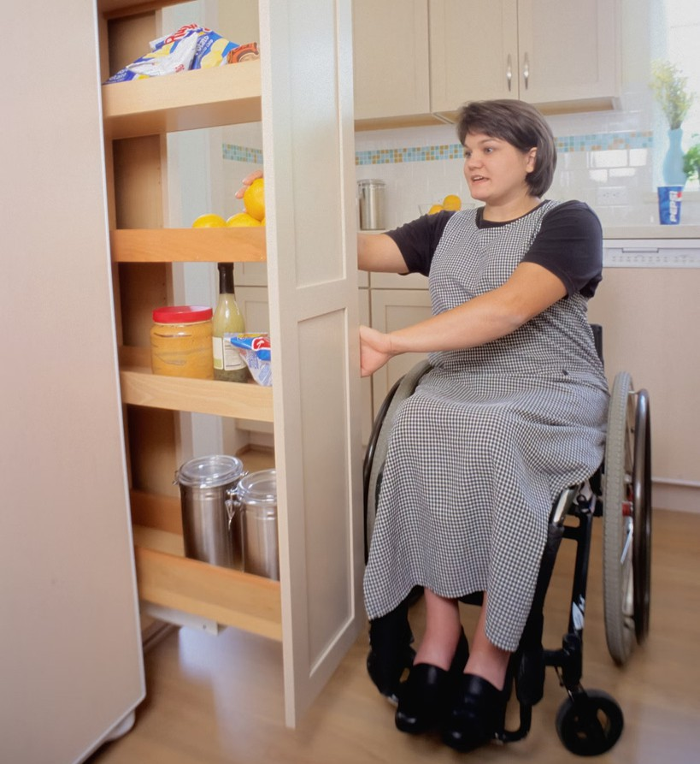
User-Based KNN
Collaborative | Item-Based KNN | Surprise Library
Filtering for personal recommendations | Improving recommendation accuracy | Enhances appeal and advantages

Slide 5


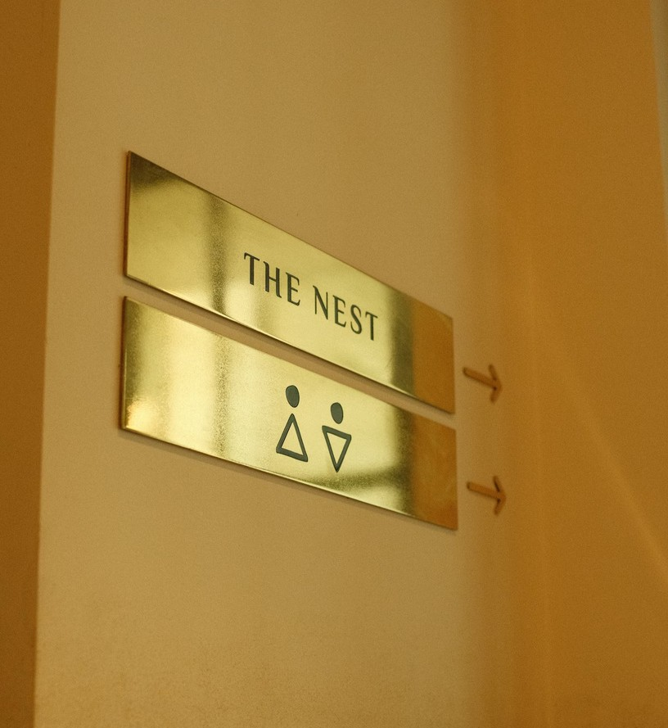
Item-Based KNN
Collaborative
Item similarity used for generating recommendations
Surprise Library
Leverage SVD model from Scikit-Surprise for precise results
Enhanced Recommendations
Deliver personalized suggestions with Item-Based KNN

Slide 6
Surprise Library
User-Based
Personalized recommendations based on user behavior.
Item-Based
Recommendations based on similar item attributes.

Slide 7
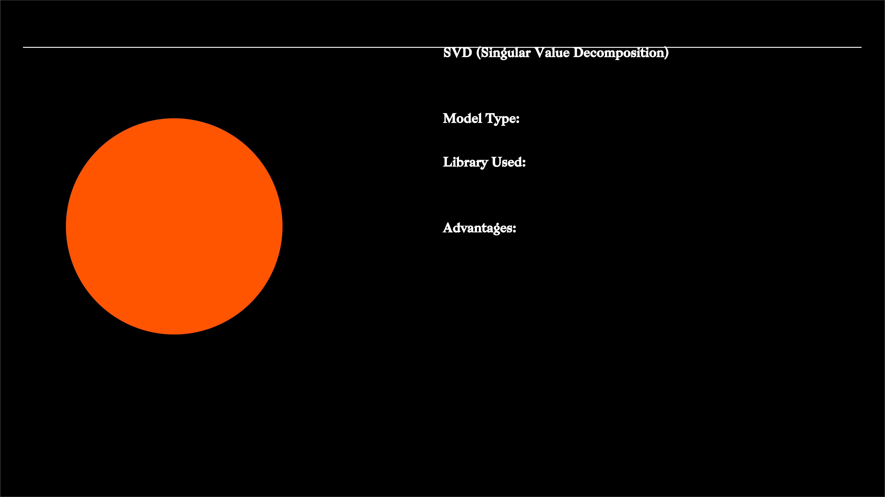
25 April 2025
SVD (Singular Value Decomposition)
Model Type: Matrix Factorization
Library Used: Surprise (Scikit-Surprise)
Advantages
Advantages:
Captures hidden patterns between users and movies
Provides personalized and accurate recommendations Handles sparse data effectively
Scales well for large datasets
Supports regularization to reduce overfitting

Slide 8

User-Based KNN (K-Nearest Neighbors)
Model Type: Collaborative Filtering (User-Based)
Library Used: KNNBasic(user_based=True) in Surprise
Advantages:
Simple and easy to understand
Recommends based on similar users' preferences
Good for recommending new movies (cold-start for items Explains recommendations using similar users

Slide 9

Item-Based KNN (K-Nearest Neighbors)
Model Type: Collaborative Filtering (Item-Based)
Library Used: KNNBasic(user_based=False) in Surprise
Advantages:
More stable recommendations over time Great for suggesting similar movies
Fast recommendation process once item similarities are computed Works well even for users with few ratings

Slide 10
Expertise Leverage
By using smart techniques like User-Based KNN, Item-Based KNN, and advanced models like SVD from the Surprise (Scikit-Surprise) library, we can improve our recommendation system. These methods help us make better, more personalized suggestions that enhance user satisfaction and bring added benefits to the system.
25 April 2025

Slide 11

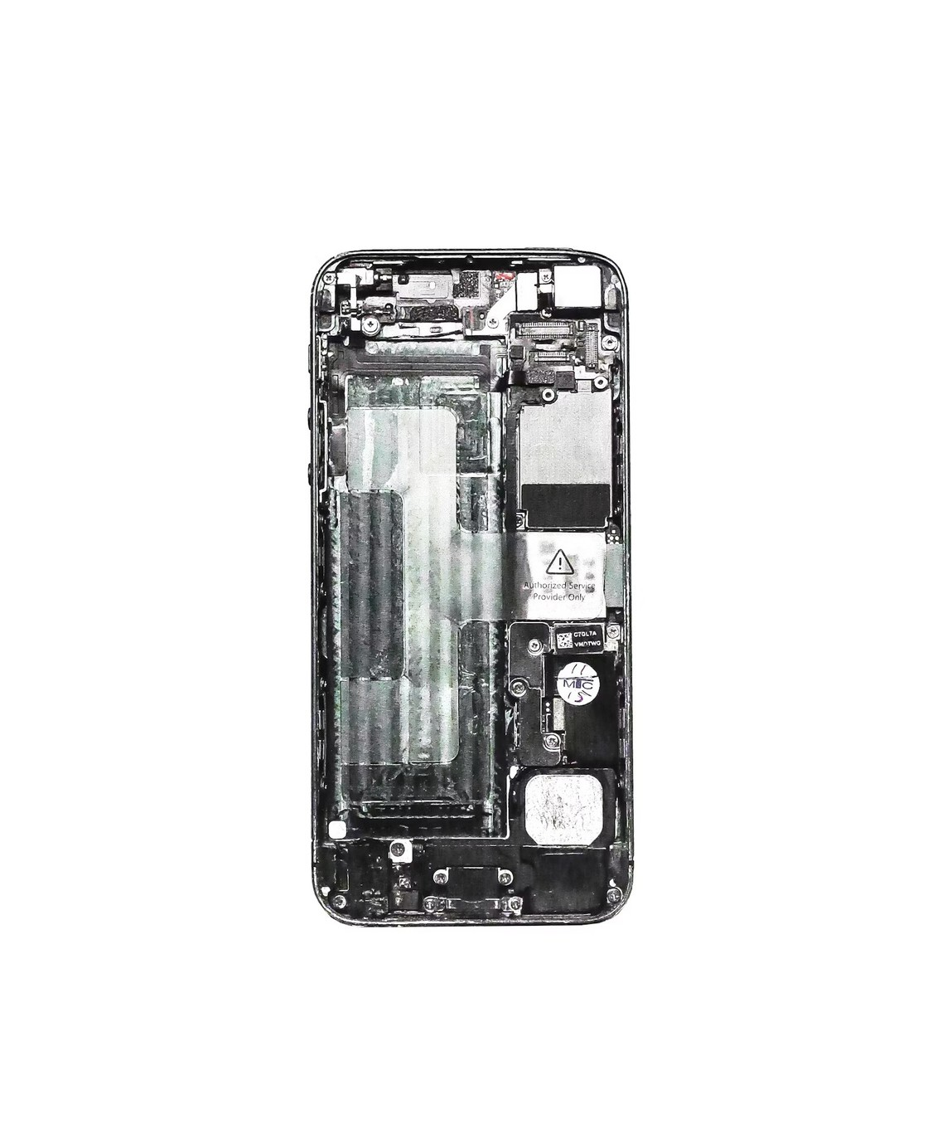
Conclusion
"This is just the beginning— recommendation systems will only get smarter, faster, and more user- friendly as we continue to explore new technologies and data insights."

